Slide 1
01
FINAL PROJECT PRESENTATION · PHASE 1 — PROPOSAL & ANALYSIS
THREATLENS
Threat Detection & URL Scanner
UNIFIED 0–100 RISK SCORE
URL SCANNING
PHISHING ANALYSIS
THREAT INTELLIGENCE
Prepared by:
Apurva Bharoliya · 1003
Minhaz Malek · 1039
Jeal Rajpal · 1050
Priyansh Pal · 1149
Course: IMCA - 7th Semester · Guide: Divya Mudaliar · August 2026
ThreatLens • Threat Detection & URL Scanner

Slide 2
02
1 · INITIAL PROJECT PROPOSAL & PLANNING
Project Proposal — Idea, Objectives & Scope
The idea: turn any URL into an evidence-backed 0–100 risk score with an itemized, explainable breakdown — plus phishing-content analysis, history and a browser extension.
MOTIVATION
OBJECTIVES
SCOPE
▸ Phishing & malicious URLs are a top initial-access vector for breaches.
▸ Look-alike domains are indistinguishable to the human eye.
▸ Threat signals are scattered across WHOIS, SSL, blocklist and AV tools.
▸ Verdicts are opaque — users cannot see why a link was flagged.
▸ Unified 0–100 score with human-readable findings.
▸ Five-stage scan pipeline — parse → heuristics → metadata → intel → score.
▸ Phishing analysis for email / SMS / text, headers and embedded links.
▸ History, watchlist, bulk scan and a Chrome extension.
▸ IN: URL scanning, phishing lab, auth, admin, history, watchlist, bulk & extension.
▸ OUT: ML training, file sandboxing, SMTP integration, mobile apps, public SaaS.
ThreatLens • Threat Detection & URL Scanner
THREATLENS · THREAT DETECTION & URL SCANNER
02

Slide 3
2 · STUDENTS FINALIZE PROJECT TITLE
03
Finalized Project Title
SELECTED TITLE
ThreatLens — Threat Detection & URL Scanner
A concise title that directly represents the system’s scope:
• Threat detection for malicious and suspicious URLs
• Phishing-content analysis
• Threat-intelligence integration
• Explainable risk scoring and reporting
WHY THIS TITLE
• “ThreatLens” communicates inspection, visibility, and analysis.
• “Threat” covers malicious URLs, phishing content, and intelligence.
• “Lens” reflects the goal of making security evidence understandable.
• The name is consistent across the dashboard, backend, database documentation, and browser extension.
FINAL TITLE: ThreatLens
ThreatLens • Threat Detection & URL Scanner

Slide 4
04
3 · PROBLEM STATEMENT
Define the Problem Statement
“
Users face an ever-growing wave of phishing and malicious URLs — yet existing tools answer “is this link safe?” with scattered, single-signal verdicts that are slow, opaque and hard to act on. ThreatLens solves this with one transparent, unified 0–100 risk score backed by itemized evidence — plus phishing-content analysis and a personal watchlist.
WHO
WHAT
WHY
HOW
Users, students & analysts who must judge link safety before clicking.
One explainable risk score covering URLs and phishing content.
Phishing is a leading initial-access vector; blocklists miss new domains.
Web dashboard + REST API + browser extension over a five-stage pipeline.
WHY IT MATTERS phishing is a leading initial-access vector · look-alike domains evade reactive blocklists · raw WHOIS/SSL/AV data is unreadable to most users
ThreatLens • Threat Detection & URL Scanner
THREATLENS · THREAT DETECTION & URL SCANNER
05

Slide 5
4 · CONDUCT SYSTEM ANALYSIS
05
4.1 — Study the Existing System and Its Limitations
BROWSER SAFE BROWSING
Reactive blocklists
• Limited explanation
• No unified risk score
• New threats can evade reactive lists
VIRUSTOTAL / MULTI-AV
Raw vendor results
• Fragmented signals
• Hard for non-experts to interpret
• No consolidated user workflow
MANUAL / AD-HOC CHECKS
WHOIS / SSL / web searches
• Expert-oriented
• Single-signal inspection
• No structured evidence trail
• No history or watchlist
ThreatLens • Threat Detection & URL Scanner

Slide 6
06
4 · SYSTEM ANALYSIS
4.2 Proposed System — Functionality
Overview: a full-stack threat-detection platform — FastAPI backend, five-stage scan pipeline, phishing engine, per-user history & watchlist, web dashboard and browser extension.
UNIFIED SCORING
URL SCAN PIPELINE
PHISHING LAB
Transparent 0–100 score, every deduction itemized & readable.
Parse → heuristics → metadata → intel → score (async, parallel).
Email/SMS/text analysis, header checks, sender check, link inspection.
HISTORY & REPORTS
WATCHLIST
THREAT INTELLIGENCE
Persisted scans, filters, stats, full activity report (CSV/JSON/HTML).
Save senders / domains / URLs; auto-alert on new matches.
VirusTotal, Safe Browsing, PhishTank — optional, degrade gracefully.
1 · PARSE
2 · HEURISTICS
3 · METADATA
4 · THREAT INTEL
5 · SCORING
tldextract
typosquat · entropy
WHOIS·SSL·HTTP
VT·GSB·PhishTank
0–100 + verdict
ThreatLens • Threat Detection & URL Scanner
THREATLENS · THREAT DETECTION & URL SCANNER
07

Slide 7
07
4 · SYSTEM ANALYSIS
4.2 Modules & Sub-Modules
Module | Sub-modules
Authentication & Users | Register · login/logout · profile · change password · admin roles · rate limiting
URL Scanner | URL parser · heuristics · WHOIS/SSL/HTTP metadata · threat intel · risk scoring
Phishing Analyzer | Content NLP rules · header parser · sender check · link inspector · trends
History & Reporting | Scan history · phishing history · activity report · CSV/JSON/HTML export
Watchlist | Sender / domain / URL indicators · auto-matching inside analyses
Threat Intelligence | Provider status · verdict feed · config-driven optional keys
Bulk Scanner | Up to 25 URLs in parallel · per-URL failure isolation · CSV export
Browser Extension | Popup scan · context menus · score badge · full-report tab · settings
Admin Panel | Global stats · user management · visibility into all users’ scans
Frontend Dashboard | Scanner · phishing lab · learn · history · intel · profile pages
ThreatLens • Threat Detection & URL Scanner
THREATLENS · THREAT DETECTION & URL SCANNER
08

Slide 8
08
5 · TECHNICAL SPECIFICATIONS
5.1–5.2 Requirements & System Architecture
HARDWARE / CLIENT
SOFTWARE / TECHNOLOGY
▸ Server: 2-core CPU, 4 GB RAM, 1 GB disk
▸ Client: any modern browser; extension on Chrome/Edge/Brave
▸ Network: internet access for WHOIS/SSL/HTTP + intel feeds
▸ Backend: Python 3.11+ · FastAPI · Uvicorn · Pydantic 2
▸ Data: SQLAlchemy 2 ORM · SQLite (Postgres-ready)
▸ Analysis: tldextract · python-whois · requests
▸ Frontend: HTML5 · CSS3 · vanilla JS · Git & GitHub
LAYERED ARCHITECTURE
CLIENT
Web dashboard (HTML/CSS/JS) · Chrome extension · REST clients
API
FastAPI (async) — auth, scanner, phishing, tools, history, intel, admin
SERVICES
url_parser · heuristics · metadata · threat_intel · phishing_analyzer · risk_scoring
DATA
SQLite via SQLAlchemy — users, tokens, scans, analyses, watchlist
EXTERNAL
WHOIS · SSL · HTTP · VirusTotal · Google Safe Browsing · PhishTank (optional)
ThreatLens • Threat Detection & URL Scanner
THREATLENS · THREAT DETECTION & URL SCANNER
10

Slide 9
6 · SYSTEM DESIGN
07
6.1 System Architecture Overview
ThreatLens is built as a three-part platform: web dashboard, FastAPI backend, and Chrome extension, backed by SQLite and optional external threat-intelligence providers.
WEB DASHBOARD
FASTAPI BACKEND
CHROME EXTENSION
REST CLIENTS
HTML5 · CSS3 · Vanilla JS
Auth · Scan · Phishing · Admin · REST API
Manifest V3 · Popup · Context menu
API consumers
BUSINESS SERVICES
url_parser · heuristics · metadata · threat_intel · phishing_analyzer · risk_scoring · watchlist · security
SQLITE DATABASE
EXTERNAL THREAT INTELLIGENCE
SQLAlchemy ORM · users · tokens · scans · analyses · watchlist · audit · API keys · webhooks
VirusTotal · Google Safe Browsing · PhishTank · optional API keys
Design principle: the core pipeline continues to work without paid API keys; external providers enrich the result when configured.
ThreatLens • Threat Detection & URL Scanner
ThreatLens · System Design & Database Development
ThreatLens v1.0 · Sep 2026

Slide 10
6 · SYSTEM DESIGN
08
6.2 URL Scan Pipeline & Risk Scoring
Raw URL → parse → heuristics → metadata → threat intelligence → scoring → persistence → report
1
2
3
4
5
PARSE & NORMALIZE
HEURISTICS
METADATA
THREAT INTEL
RISK SCORING
scheme · host · port · path · TLD · IP detection
typosquat · TLD · entropy · URL structure
WHOIS · SSL · HTTP · redirects · SSRF guard
VirusTotal · GSB · PhishTank (optional)
start 100 · apply findings · clamp 0–100
OUTPUT · JSON RISK REPORT
VERDICT THRESHOLDS
• risk_score · verdict · risk_level
• findings[] · category_totals{}
• metadata{whois, ssl, http} · threat_intel{vt, gsb, pt} · scanned_at
≥ 85
SAFE
70–84
LOW RISK
40–69
SUSPICIOUS
< 40
DANGEROUS
Source: System Design PDF, pp. 4 & 17–20. Scoring starts at 100 and each finding contributes additive points before clamping to 0–100.
ThreatLens • Threat Detection & URL Scanner
ThreatLens · System Design & Database Development
ThreatLens v1.0 · Sep 2026

Slide 11
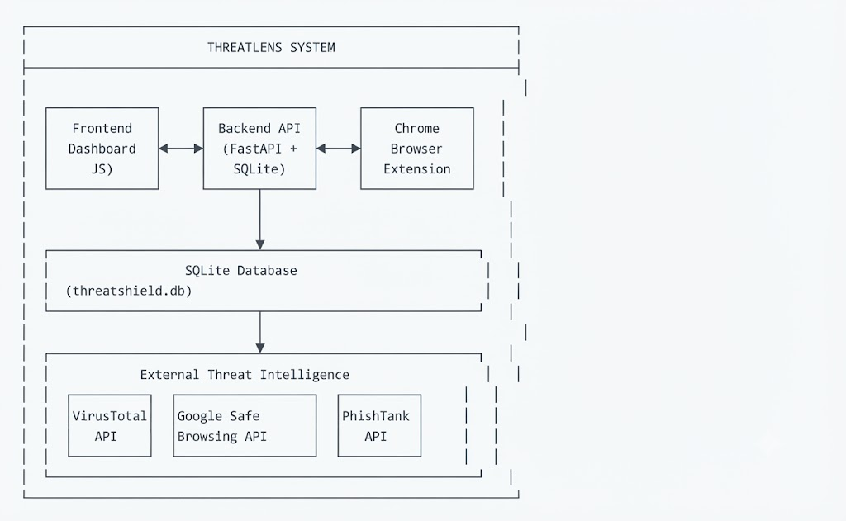
09
System Architecture
ThreatLens • Threat Detection & URL Scanner
ThreatLens · System Design & Database Development
ThreatLens v1.0 · Sep 2026

Slide 12
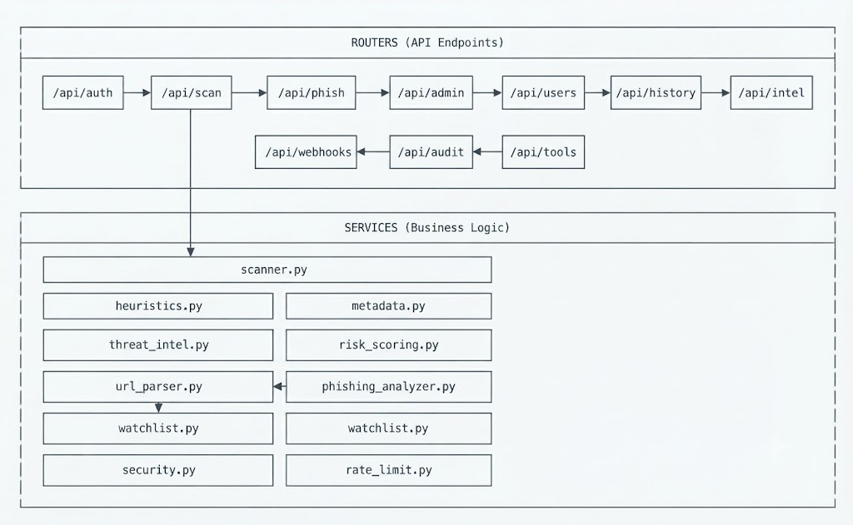
09
Router-to-Services
ThreatLens • Threat Detection & URL Scanner
ThreatLens · System Design & Database Development
ThreatLens v1.0 · Sep 2026

Slide 13
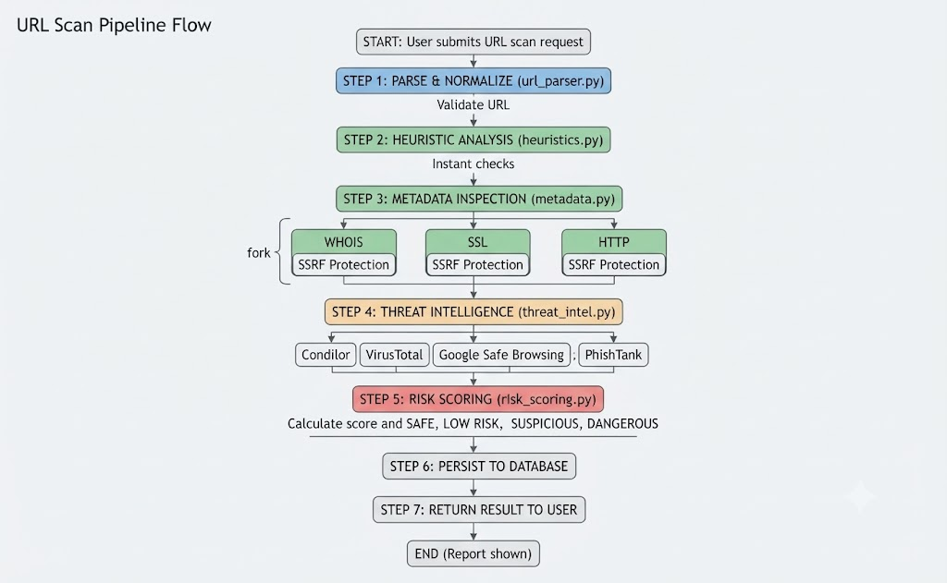
09
URL Scan Pipeline Flow
ThreatLens • Threat Detection & URL Scanner
ThreatLens · System Design & Database Development
ThreatLens v1.0 · Sep 2026

Slide 14
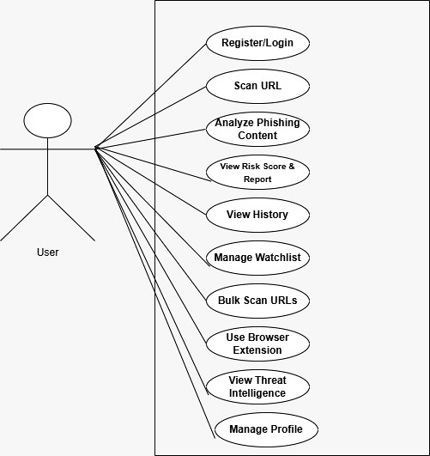
7 · PREPARE UML DIAGRAMS
09
7.1 Use Case Diagram — User
Authenticated user interactions with ThreatLens
KEY USER CAPABILITIES
• Register / Login
• Scan a single URL
• Analyze phishing content
• View risk score & report
• View scan / phishing history
• Manage sender / domain / URL watchlist
• Bulk scan up to 25 URLs
• Use browser extension
• View threat intelligence
• Manage profile
ThreatLens • Threat Detection & URL Scanner
ThreatLens · System Design & Database Development
ThreatLens v1.0 · Sep 2026

Slide 15
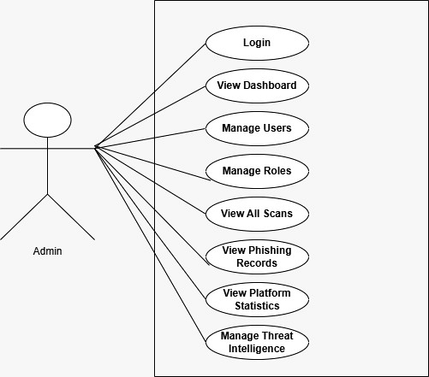
7 · PREPARE UML DIAGRAMS
10
7.2 Use Case Diagram — Admin
Administrative interactions and privileged platform management functions
ADMIN-ONLY FUNCTIONS
• Login
• View dashboard
• Manage users
• Manage roles & permissions
• View all scans
• View phishing records
• View platform statistics
• Manage threat intelligence providers / API keys
Privilege boundary: admin actions are protected by role checks / 403 gating.
ThreatLens • Threat Detection & URL Scanner
ThreatLens · System Design & Database Development
ThreatLens v1.0 · Sep 2026

Slide 16
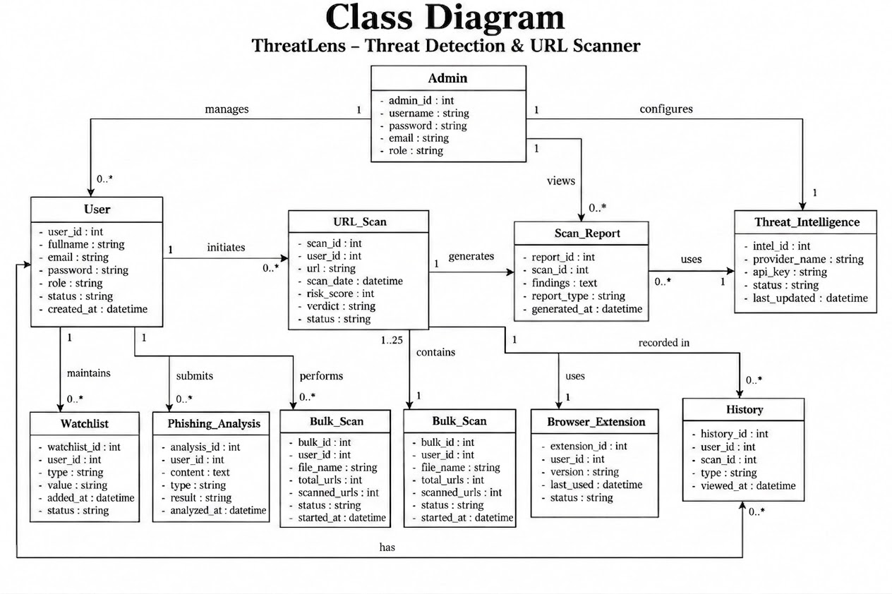
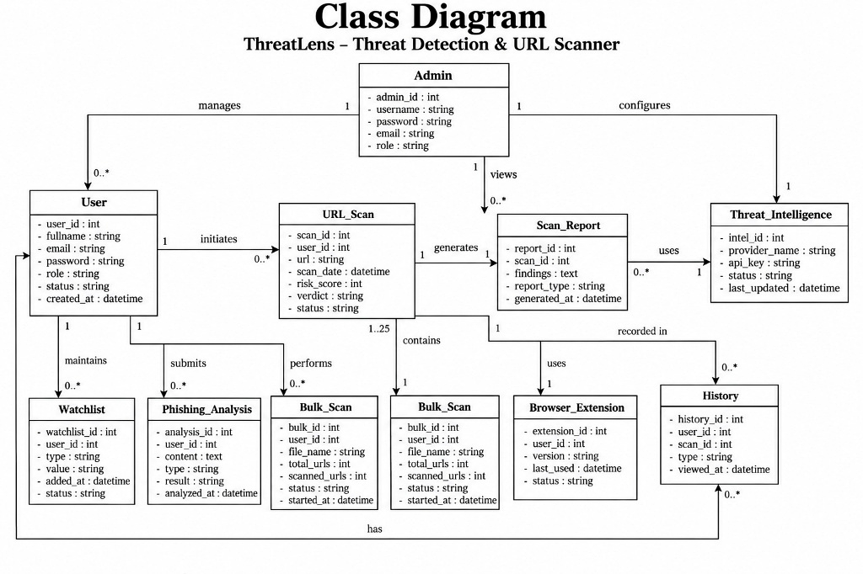
7 · PREPARE UML DIAGRAMS
12
7.2 Class Diagram — Domain & Persistence Model
Entity relationships covering users, scans, phishing analysis, watchlists, browser extension data and threat intelligence
ThreatLens • Threat Detection & URL Scanner
ThreatLens · System Design & Database Development
ThreatLens v1.0 · Sep 2026

Slide 17
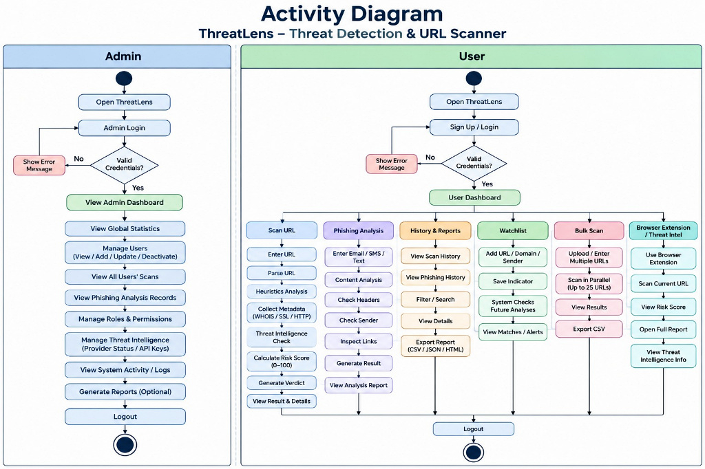
7 · PREPARE UML DIAGRAMS
11
7.3 Activity Diagram — ThreatLens Workflow
Full user workflow from authentication and rate limiting to report rendering
ThreatLens • Threat Detection & URL Scanner
ThreatLens · System Design & Database Development
ThreatLens v1.0 · Sep 2026

Slide 18
8 · CREATE DATA DICTIONARY
13
8.2 Core Tables — users & auth_tokens
TABLE: users
Column | Type | Null | Default | Description
id | INTEGER PK | NOT NULL | AUTOINC | Primary key; indexed
username | STRING(24) | NOT NULL | — | Unique login name; 3–24 chars [a-zA-Z0-9_]
email | STRING(254) | NOT NULL | — | Unique, indexed; stored lowercase
password_hash | STRING(255) | NOT NULL | — | PBKDF2-HMAC-SHA256 password hash
display_name | STRING(50) | NULLABLE | NULL | Optional friendly display name
is_admin | BOOLEAN | NOT NULL | FALSE | Admin privilege flag
created_at | DATETIME | NOT NULL | utcnow() | Account creation timestamp (UTC)
TABLE: auth_tokens
Column | Type | Null | Default | Description
id | INTEGER PK | NOT NULL | AUTOINC | Primary key; indexed
token | STRING(64) | NOT NULL | — | Bearer token; indexed & unique
user_id | INTEGER FK | NOT NULL | — | FK → users.id; ON DELETE CASCADE
created_at | DATETIME | NOT NULL | utcnow() | Token creation time (UTC)
expires_at | DATETIME | NOT NULL | — | Token expiry; 30 days from creation
Source: Data Dictionary, PDF pp. 24–25.
ThreatLens • Threat Detection & URL Scanner
ThreatLens · System Design & Database Development
ThreatLens v1.0 · Sep 2026

Slide 19
8 · CREATE DATA DICTIONARY
14
8.3 Core Tables — scans & phishing_analyses
TABLE: scans
Column | Type | Null | Default | Description
id | INTEGER PK | NOT NULL | AUTOINC | Primary key; indexed
user_id | INTEGER FK | NULLABLE | NULL | FK → users.id; SET NULL; NULL = anonymous scan
url | STRING(2048) | — | — | Normalized URL; indexed
risk_score | INTEGER | — | — | Risk score 0–100; 100 = safest
verdict | STRING(50) | — | — | SAFE / LOW RISK / SUSPICIOUS / DANGEROUS
summary | TEXT | — | {} | JSON summary of scan
findings | TEXT | — | [] | JSON array of itemized findings
created_at | DATETIME | NOT NULL | utcnow() | Scan timestamp; UTC; indexed
TABLE: phishing_analyses
Column | Type | Null | Default | Description
id | INTEGER PK | NOT NULL | AUTOINC | Primary key
user_id | INTEGER FK | NULLABLE | NULL | FK → users.id; SET NULL
content_type | STRING(50) | — | email | email | sms | page_text
content_preview | STRING(500) | — | "" | First 400 chars of analyzed content
phishing_score | INTEGER | — | — | 0–100; higher = more likely phishing
verdict | STRING(50) | — | — | SAFE / SUSPICIOUS / PHISHING
flags | TEXT | — | [] | JSON array of detection flags
created_at | DATETIME | NOT NULL | utcnow() | Analysis timestamp; UTC; indexed
ThreatLens • Threat Detection & URL Scanner
ThreatLens · System Design & Database Development
ThreatLens v1.0 · Sep 2026

Slide 20
8 · CREATE DATA DICTIONARY
15
8.4 Core Tables — watchlist_entries & audit_log
TABLE: watchlist_entries
Column | Type | Null | Default | Description
id | INTEGER PK | NOT NULL | AUTOINC | Primary key
user_id | INTEGER FK | NOT NULL | — | FK → users.id; CASCADE
kind | STRING(10) | NOT NULL | — | sender | domain | url
value | STRING(2048) | NOT NULL | — | Email address, domain or URL
note | STRING(200) | NULLABLE | NULL | Optional user note; max 200 chars
created_at | DATETIME | NOT NULL | utcnow() | When added; UTC
last_seen_at | DATETIME | NULLABLE | NULL | Last matched; UTC
TABLE: audit_log
Column | Type | Null | Default | Description
id | INTEGER PK | NOT NULL | AUTOINC | Primary key
user_id | INTEGER FK | NULLABLE | NULL | FK → users.id; SET NULL
action | STRING(100) | NOT NULL | — | user.promote | user.demote | user.delete
detail | TEXT | NULLABLE | NULL | JSON or human-readable detail
ip_address | STRING(45) | NULLABLE | NULL | Client IPv4 / IPv6 address
created_at | DATETIME | NOT NULL | utcnow() | Action timestamp; UTC; indexed
ThreatLens • Threat Detection & URL Scanner
ThreatLens · System Design & Database Development
ThreatLens v1.0 · Sep 2026

Slide 21
8 · CREATE DATA DICTIONARY
16
8.5 Supporting Tables — api_keys & webhooks
TABLE: api_keys
Column | Type | Null | Default | Description
id | INTEGER PK | NOT NULL | AUTOINC | Primary key
user_id | INTEGER FK | NOT NULL | — | FK → users.id; CASCADE
key_hash | STRING(128) | NOT NULL | — | Hashed API key; unique, indexed
name | STRING(100) | — | default | Human label
prefix | STRING(8) | NOT NULL | — | First 8 chars for display
is_active | BOOLEAN | NOT NULL | TRUE | Currently active?
last_used_at | DATETIME | NULLABLE | NULL | Last used (UTC)
created_at | DATETIME | NOT NULL | utcnow() | Creation time (UTC)
expires_at | DATETIME | NULLABLE | NULL | Optional expiry
TABLE: webhooks
Column | Type | Null | Default | Description
id | INTEGER PK | NOT NULL | AUTOINC | Primary key
user_id | INTEGER FK | NOT NULL | — | FK → users.id; CASCADE
url | STRING(2048) | NOT NULL | — | Webhook endpoint; HTTP/S only
secret | STRING(64) | NOT NULL | — | HMAC-SHA256 secret; 32 hex chars
events | TEXT | — | ["scan.dangerous"] | JSON array; event types or wildcard
is_active | BOOLEAN | NOT NULL | TRUE | Currently active?
last_triggered_at | DATETIME | NULLABLE | NULL | Last triggered time (UTC)
created_at | DATETIME | NOT NULL | utcnow() | Creation time (UTC)
ThreatLens • Threat Detection & URL Scanner
ThreatLens · System Design & Database Development
ThreatLens v1.0 · Sep 2026

Slide 22
8 · CREATE DATA DICTIONARY
17
8.6 Enumerated Values Reference
VERDICT VALUES
RISK LEVEL VALUES
SAFE
URL/content appears legitimate
safe
Score ≥ 85
LOW RISK
Minor concerns; generally safe (scans only)
low
Score ≥ 70 and < 85
SUSPICIOUS
Notable red flags; warrants caution
suspicious
Score ≥ 40 and < 70
DANGEROUS
High-risk URL (scan verdict only)
critical
Score < 40
WATCHLIST KIND
CONTENT TYPE
sender
Email address
email
Email body
domain
Domain name
sms
SMS / text message
url
Full URL
page_text
Web page text
FINDING SEVERITY
THREAT INTEL STATUS
critical
Severe security issue
ok
Provider query succeeded
high
Significant concern
skipped
API key not configured
medium
Moderate concern
error
Provider query failed
low
Minor concern
info
Informational only
positive
Positive signal
WEBHOOK EVENTS
scan.dangerous
Fired for DANGEROUS scan
AUTH ACTION
Wildcard: all events
user.promote
Promote to admin
user.demote
Demote from admin
user.delete
Delete user
ThreatLens • Threat Detection & URL Scanner
ThreatLens · System Design & Database Development
ThreatLens v1.0 · Sep 2026

Slide 23
8 · CREATE DATA DICTIONARY
18
8.7 Reference Data — Hardcoded Detection Knowledge
Reference lists used by the rule-based URL / phishing detection components
SUSPICIOUS TLDs · 57
tk, ml, ga, cf, gq, top, xyz, work, click, loan, men, win, bid, date, racing, review, stream, download, gdn, country, kim, science, party, link, wang, xin, monster, rest, fit, accountant, trade, website, site, online, live, club, cyou, icu, buzz, quest, cam, mom, lol, zip, mov
URL SHORTENERS · 21
bit.ly, tinyurl.com, t.co, goo.gl, ow.ly, is.gd, buff.ly, rebrand.ly, cutt.ly, shorturl.at, rb.gy, tiny.cc, s.id, v.gd, soo.gd, t.ly, lnkd.in, x.co, qr.ae
CREDENTIAL HINTS · 15
login, signin, verify, secure, account, update, confirm, wallet, auth, password, recover, unlock, validate, billing
FREE MAIL DOMAINS · 15
gmail.com, googlemail.com, yahoo.com, yahoo.co.uk, hotmail.com, outlook.com, live.com, aol.com, icloud.com, protonmail.com, proton.me, mail.com, gmx.com, zoho.com
POPULAR BRANDS
google, youtube, gmail, facebook, instagram, whatsapp, twitter / x, telegram, tiktok, snapchat, paypal, amazon, ebay, apple, icloud, microsoft, outlook, office, onedrive, netflix, spotify, twitch, linkedin, github, dropbox, steam, epicgames, coinbase, binance, blockchain, metamask, chase, wellsfargo, bankofamerica, citibank, capitalone, hsbc, barclays, fedex, ups, usps, dhl, walmart, target, bestbuy, airbnb, booking, expedia, adobe, salesforce, wordpress
ThreatLens • Threat Detection & URL Scanner
ThreatLens · System Design & Database Development
ThreatLens v1.0 · Sep 2026

Slide 24
9 · FINALIZE DATABASE SCHEMA
20
9.1 Complete Entity-Relationship View
Eight persistent entities are linked through the User root with explicit CASCADE vs SET NULL policies.
users
CASCADE = owned data removed
SET NULL = historical record kept
1 : N relationships from users
id · username · email · is_admin
auth_tokens
scans
phishing_analyses
watchlist_entries
FK: user_id
ON DELETE CASCADE
FK: user_id
ON DELETE SET NULL
FK: user_id
ON DELETE SET NULL
FK: user_id
ON DELETE CASCADE
audit_log
api_keys
webhooks
FK: user_id
ON DELETE SET NULL
FK: user_id
ON DELETE CASCADE
FK: user_id
ON DELETE CASCADE
ThreatLens • Threat Detection & URL Scanner
ThreatLens · System Design & Database Development
ThreatLens v1.0 · Sep 2026

Slide 25
9 · FINALIZE DATABASE SCHEMA
21
9.2 Index Strategy & Query Performance
Indexes support authentication lookups, per-user history retrieval, URL search, token validation and chronological reporting.
Table | Indexed columns | Purpose
users | id (PK); username (UNIQUE); email (UNIQUE) | Primary & login lookups
auth_tokens | id (PK); token (UNIQUE); user_id | Token validation; user token lookup
scans | id (PK); url; user_id; created_at | URL search; per-user history; chronological order
phishing_analyses | id (PK); user_id; created_at | Per-user analyses; chronological order
watchlist_entries | id (PK); user_id | Primary; user watchlist lookup
audit_log | id (PK); user_id; created_at | Action lookup; chronological audit trail
api_keys | id (PK); key_hash (UNIQUE); user_id | Key validation; owner lookup
webhooks | id (PK); user_id | Primary; user webhook lookup
ThreatLens • Threat Detection & URL Scanner
ThreatLens · System Design & Database Development
ThreatLens v1.0 · Sep 2026

